Slide 1

The Premiere
Kat Fernandez
Alexia Mosby
Christopher Salyers

Slide 2
The Premiere
The only immersive cinematic experience where you can star in your own movie, perform your own stunts, and attend your red carpet movie premiere
CLICK HERE FOR VIDEO TRAILER OF THE EXPERIENCE
6

Slide 3
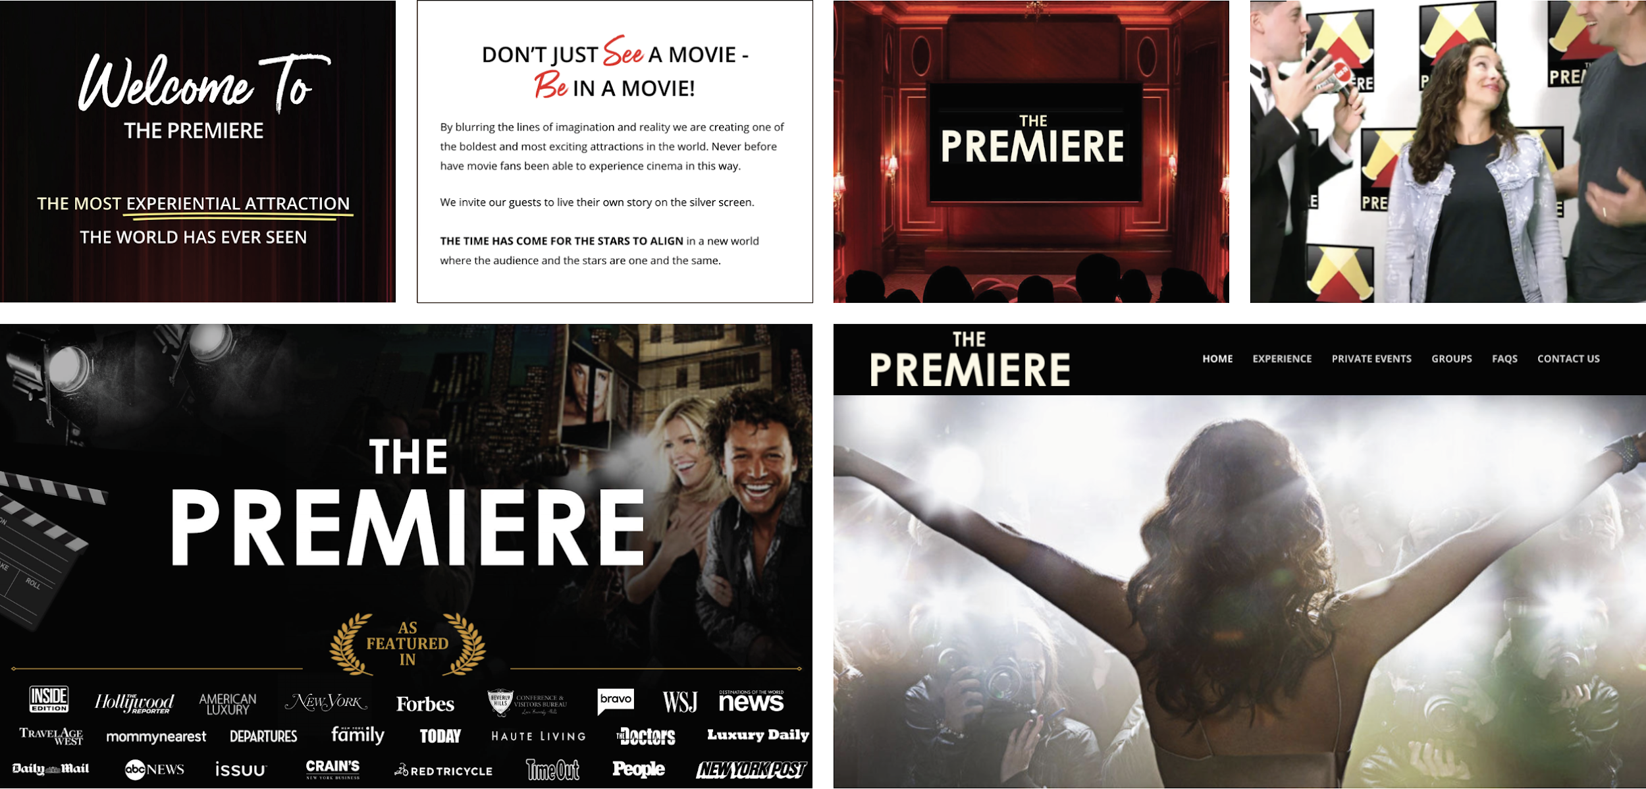
Where the brand is now
Serving private events for families & corporations. $5k+ per experience
4

Slide 4








Competition | Differentiation
The good news: The Premiere is first to market, there no direct competitors :)
Competing for share of wallet.
THE PREMIERE IMMERSIVE CINEMA EXPERIENCE
EVERYONE ELSE IMMERSIVE ENTERTAINMENT COMPETITION
3

Slide 5
Brand Strategy
v
4

Slide 6
Insight
In today’s culture, people crave
experiences over possessions.
Evidenced by the explosion of escape rooms & immersive experiences
all over the world today.
3
Notes:
Immersive experiences
soundbyte- this just isn't happening in the USA but ALL over the world.

Slide 7
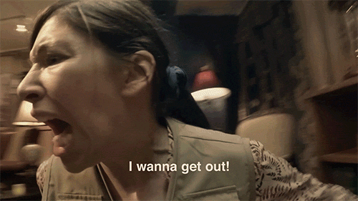
Insight
But today's immersive experiences
make you do all the work
and never put you in the center of the action.
3
Notes:
soundbyte- this just isn't happening in the USA but ALL over the world.
Example: Top global list

Slide 8
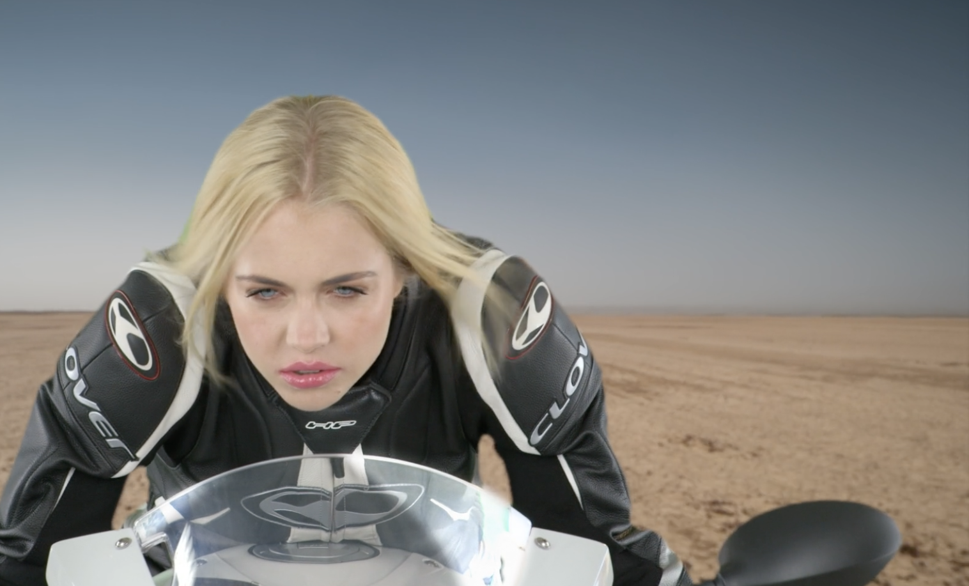
Market Disruption
You are the star
Accessible to everyone
100% immersive movie experience
3
Notes:
Be pampered like the A-list, do your own stunt and be followed around by an robotics camera, sit in hair + Makeup + Lots More! ALL in 90 minutes

Slide 9

The paparazzi experience at The Premiere is so real you might want to make a run for it
3
Notes:
The Premiere offers you a real life look into the movie making process
Be pampered like the A-list, do your own stunt and be followed around by an robotics camera, sit in hair + Makeup + Lots More! ALL in 90 minutes

Slide 10
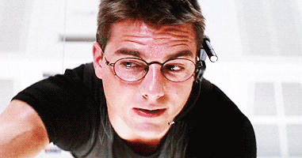
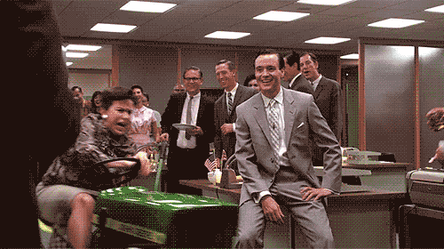
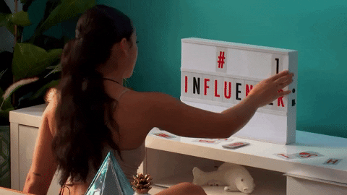
Objective
Drive mass appeal and general awareness across 3 target audiences
ACTION JACKSON
VIP + CORP EVENTS
ASPIRATIONAL INFLUENCER
3
Notes:
Classic action movie goer

Slide 11
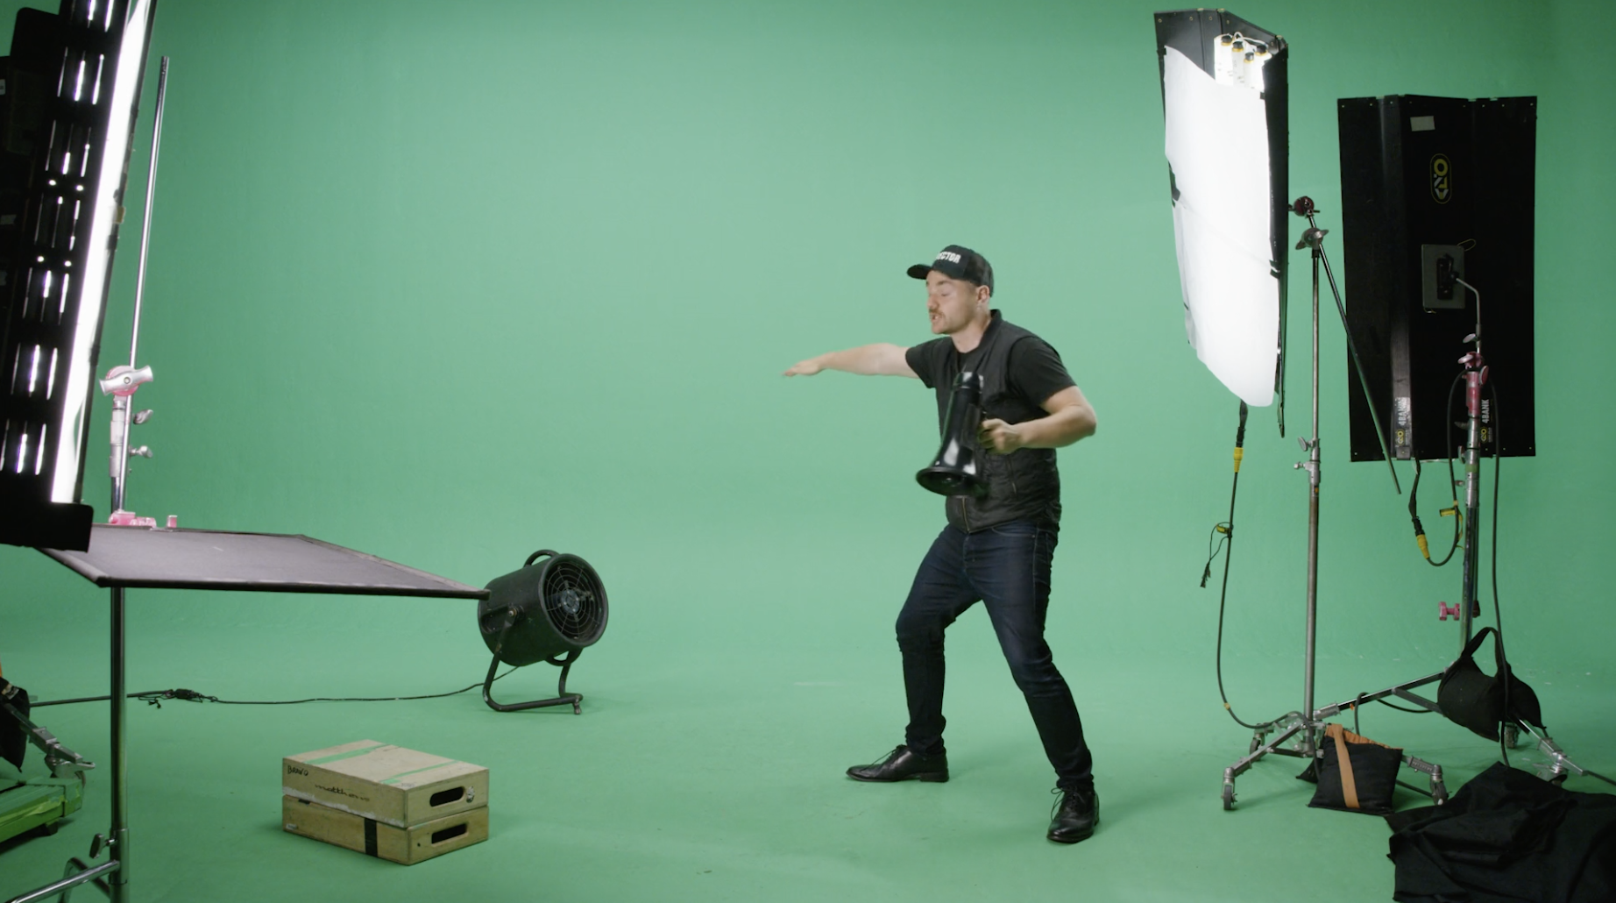
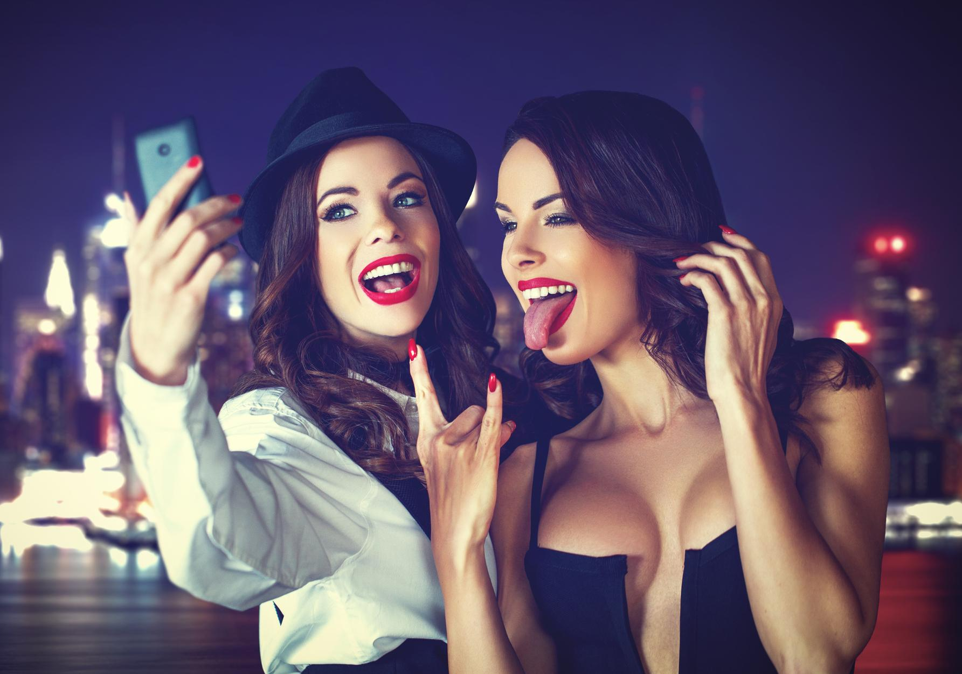
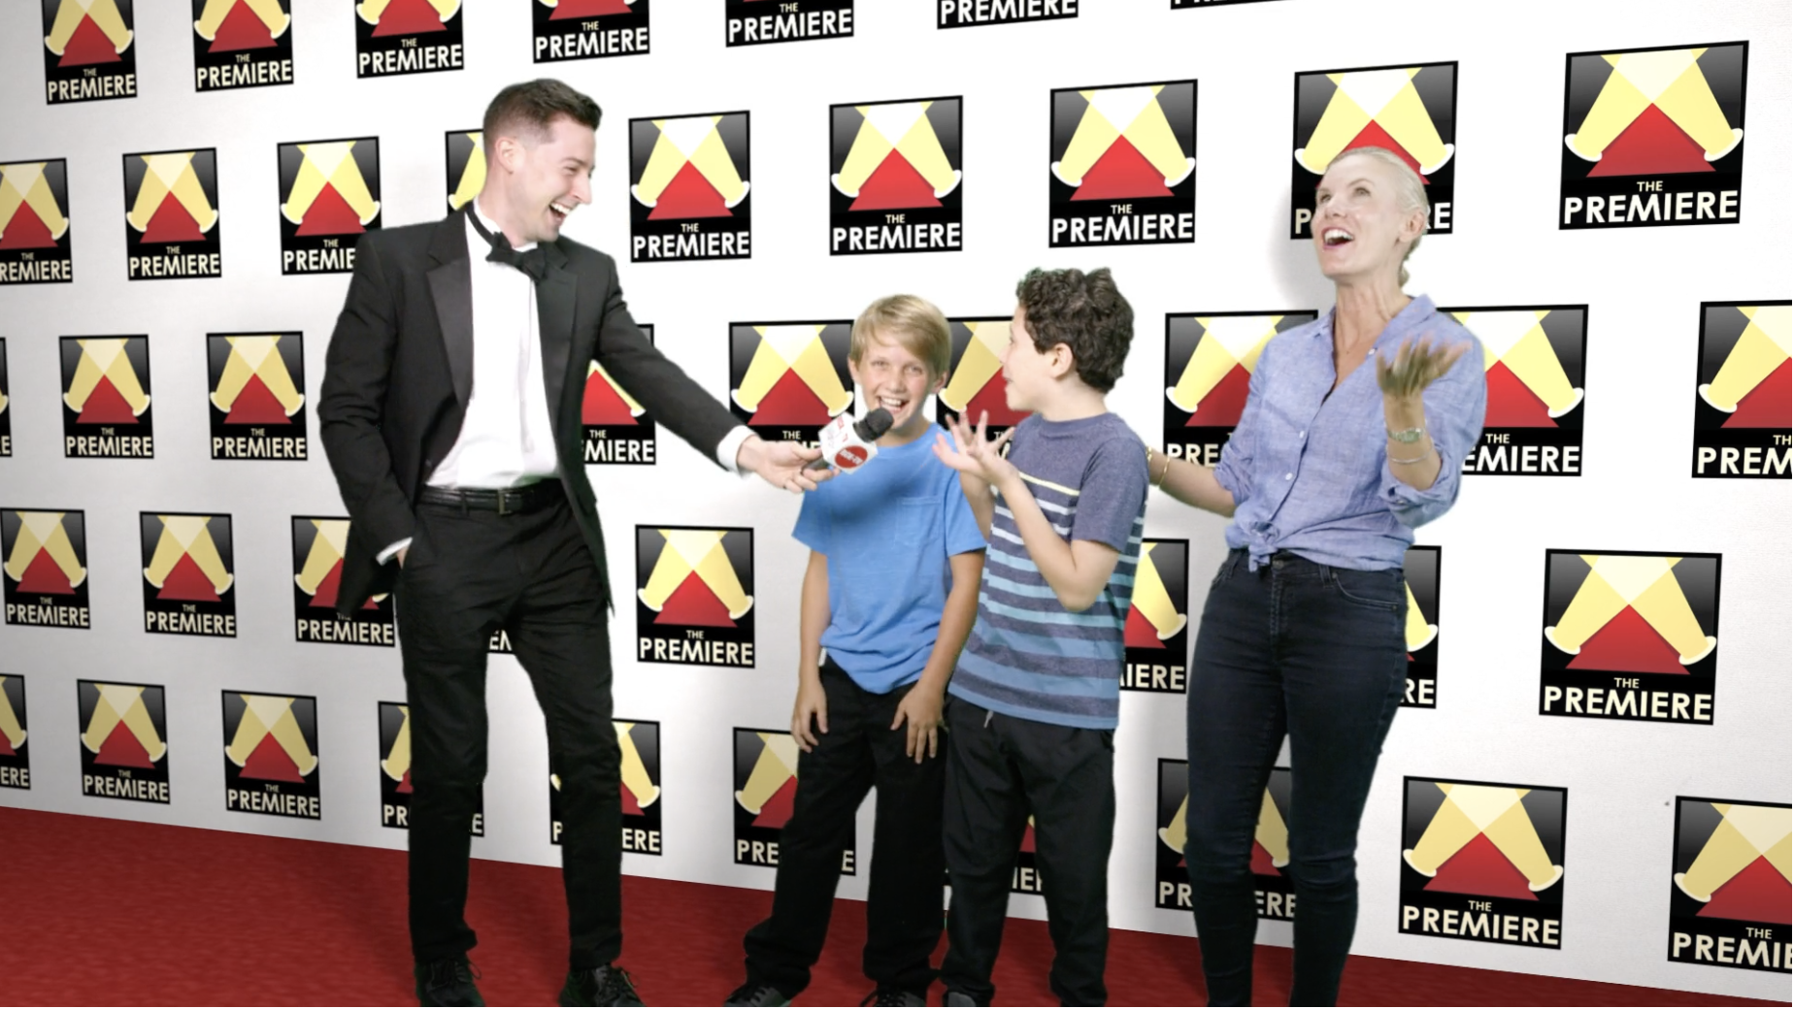
Social Media Opportunity
Develop and own content
INS & OUTS OF THE
MOVIE MAKING PROCESS
SHARED EXPERIENCES
REAL REALITY
3
Notes:
Socially driven content by the people who experience it
Share parts of the movie making process
Make every step of The Premiere an oppty for UGC
Create + produce content that drives cinematic emotion
Ins + Outs-
Tech aspects of movie process
Stuntwomen + stunt ment
Share The Experience
The Premiere offers many opportunities to take that selfie
delivering an exclusive invitation + movie badge- digital vs. print
Before + After make-up looks “Guess what I’m doing today?!”
Real Reality- physical aspect of the experience
Best Actor Awards- "Be honest, deep down inside you know you crushed that movie scene"
Behind the Scenes
Bloopers
Red Carpet
The Masses Are Here; audience, press, partners, competitors
Instagram is projected to reach 120.3M monthly active users in the US by 2020.
87% of the U.S. population is aware of Instagram.
Time spent watching video on Instagram is up more than 80% year over year.
Instagram is used to post over 55M photos and videos every day.
Because the whole world is on it!
Share parts of the movie making process
Make every step of The Premiere an oppty for UGC
Create + produce content that drives cinematic emotion
Never before can you zero-in on "Niche Audiences"

Slide 12
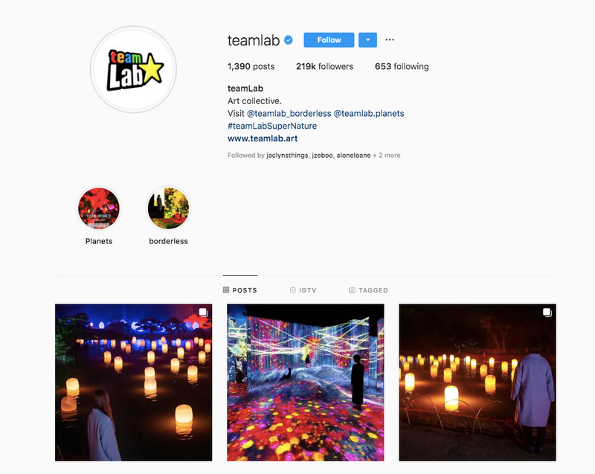
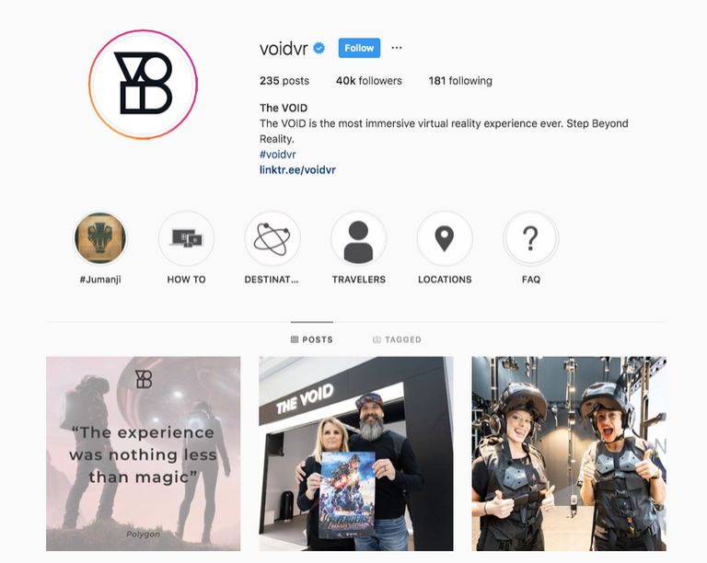
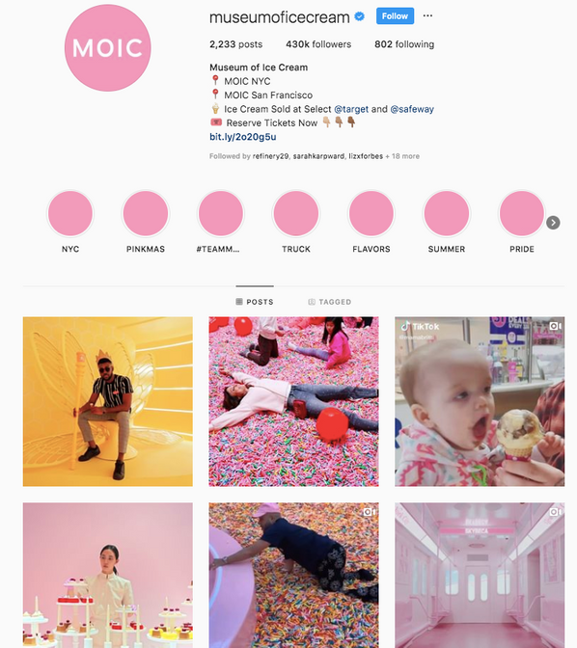
Brand Strategy
Instagram
3
Notes:
The Masses Are Here; audience, press, partners, competitors
Instagram is projected to reach 120.3M monthly active users in the US by 2020.
87% of the U.S. population is aware of Instagram.
Time spent watching video on Instagram is up more than 80% year over year.
Instagram is used to post over 55M photos and videos every day.

Slide 13
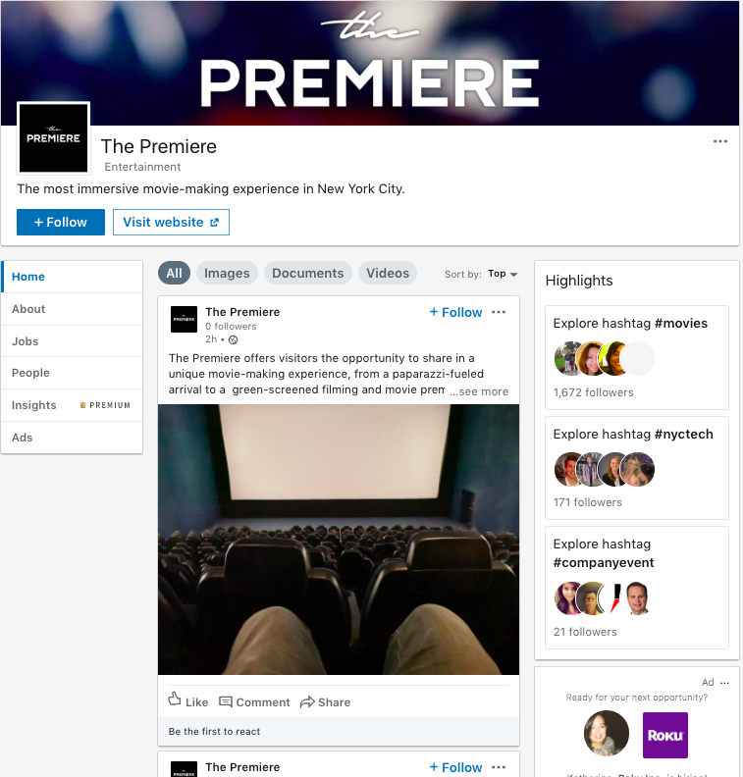
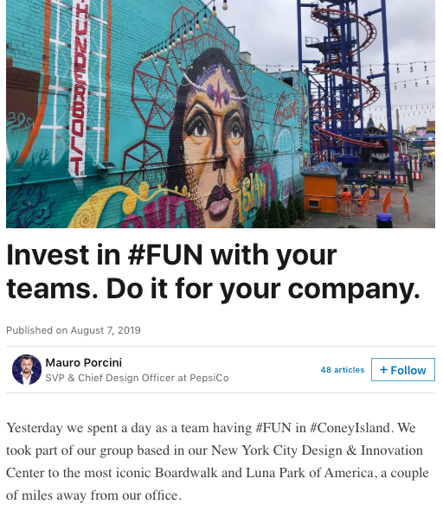
Brand Strategy
LinkedIn
3
Notes:
Biz Professionals in & outside the office
Deep Targeting Capabilities
B2C content is still underrepresented
Dynamic newsfeed that could use live action content that is filled with movie trivia, office humor and cool sophisticated stunts
C-Suite By Region
99% of HR Professionals
"The best film, food and drik all in one seat."
- 10,705 Followers
- 1,300 Employees
- Medium Post Level
- They Own their Brand
-Drive awareness of Corp Events
- Introduce new Partnerships
- Giveaways

Slide 14
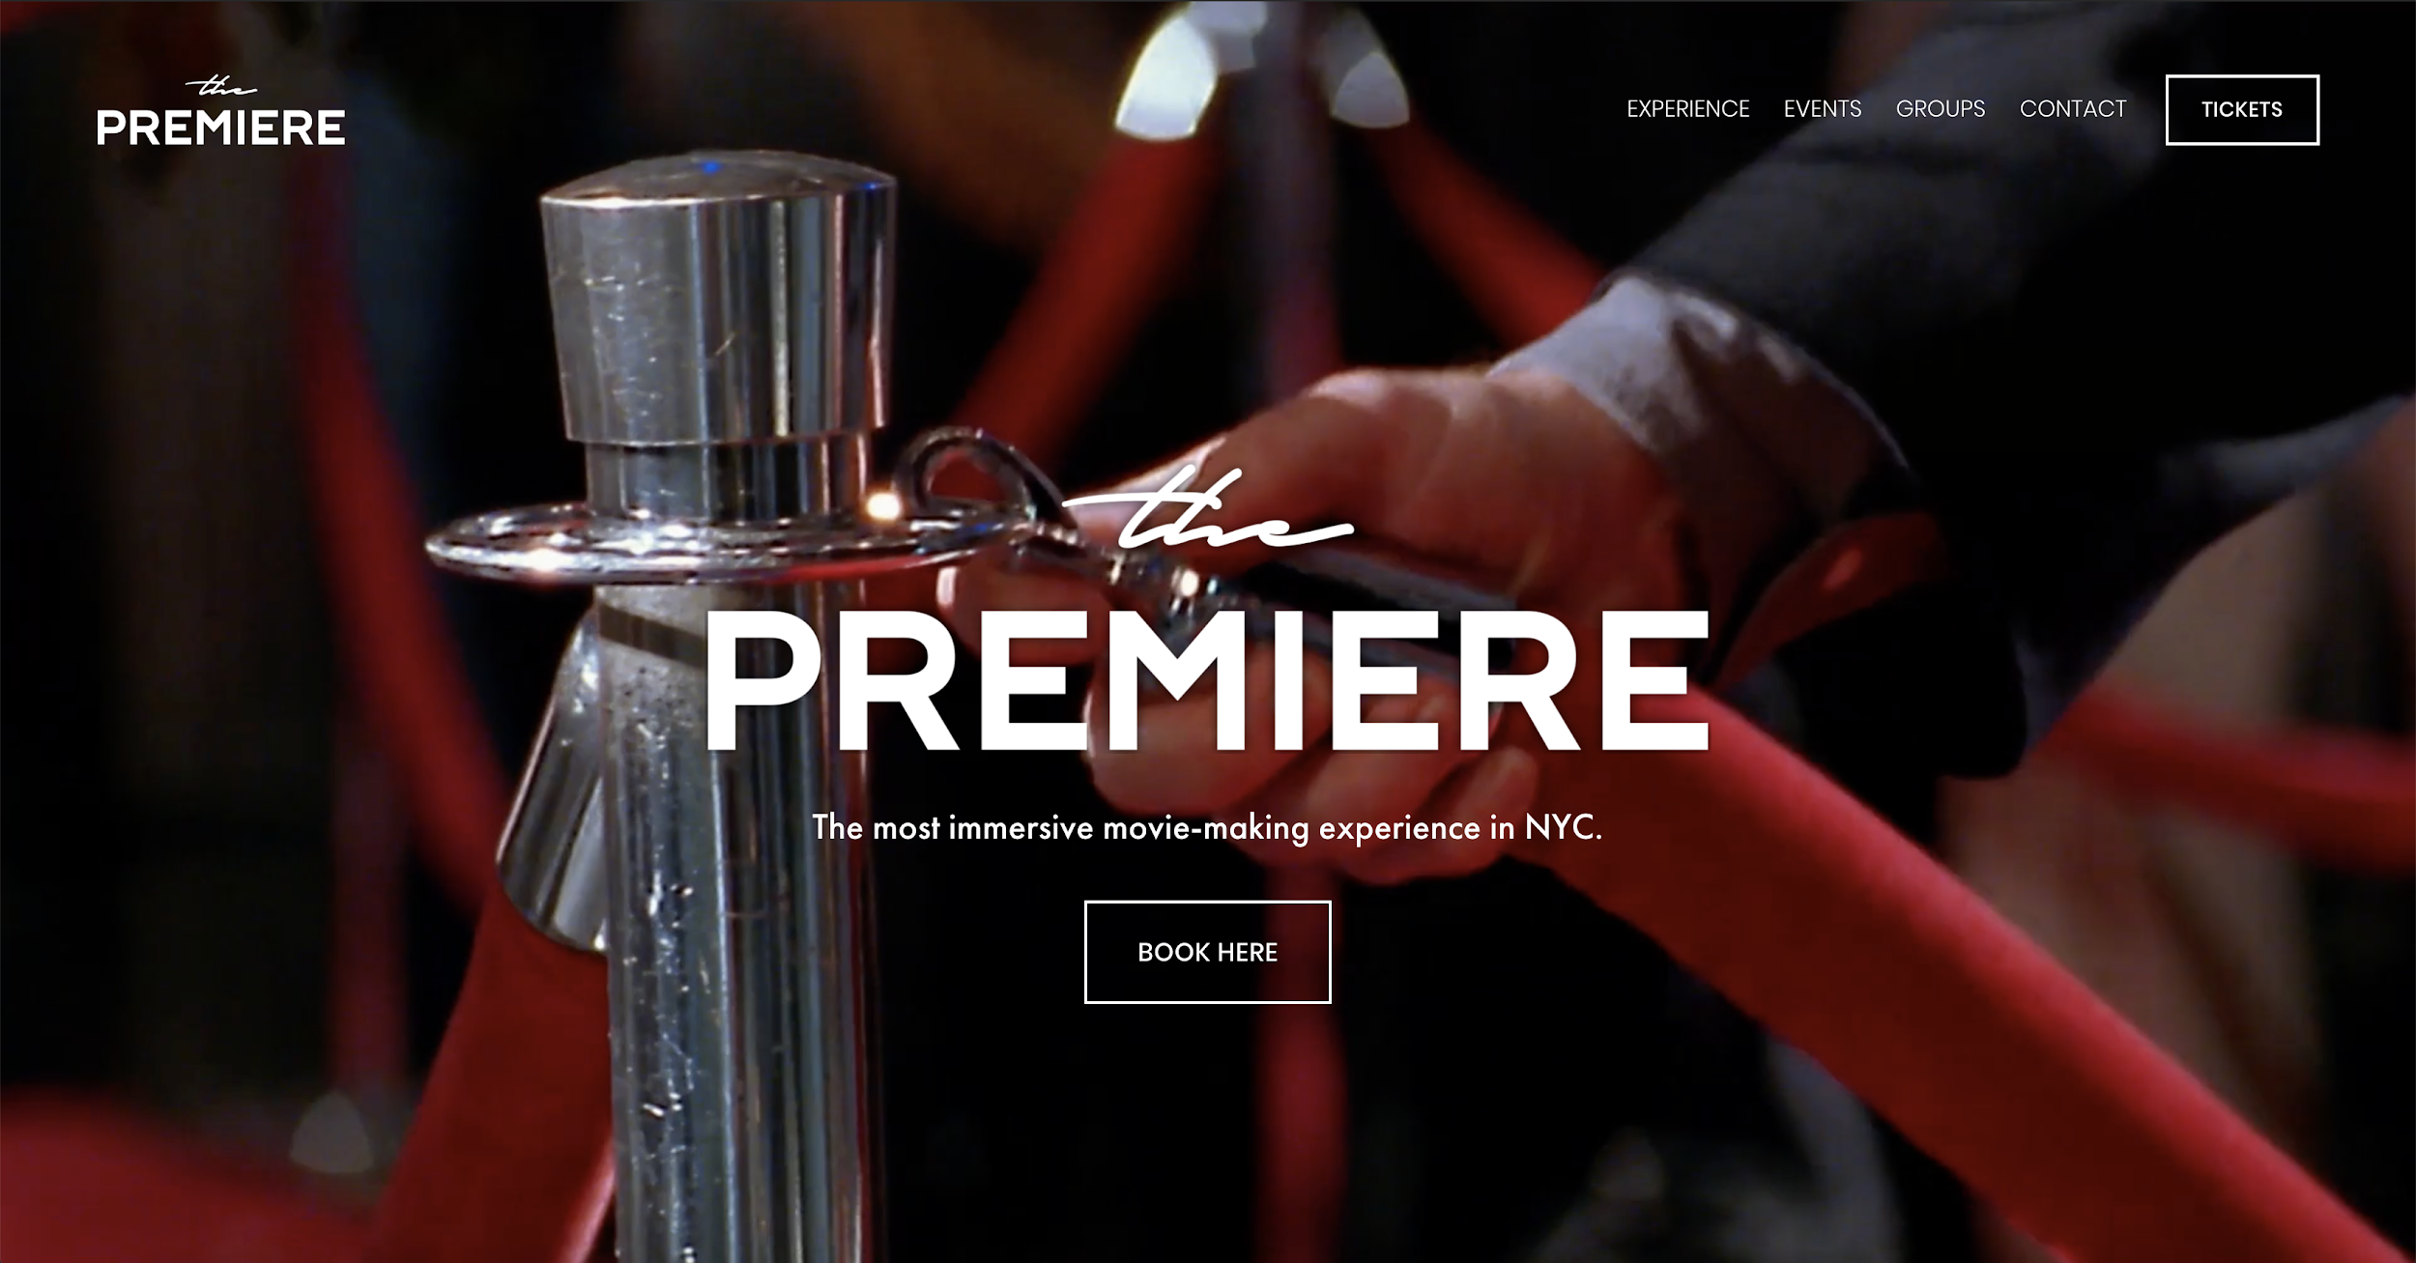
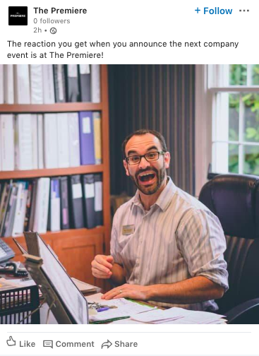


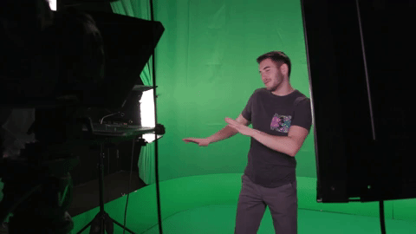
LinkedIn + Instagram
The Landscape
Path To Purchase
Played out Immersive Experience
Focused on Groups
The Premiere
Be The Big Screen
3

Slide 15
Website
OBJECTIVES
--
01: Communicate the offering
02: Cinematic cues + experiential cues
v
4
3

Slide 16
Website
3

Slide 17
Logo
OBJECTIVES
--
01: Communicate the offering
02: Cinematic cues + experiential cues
v
4

Slide 18

Logo Application
4
3

Slide 19

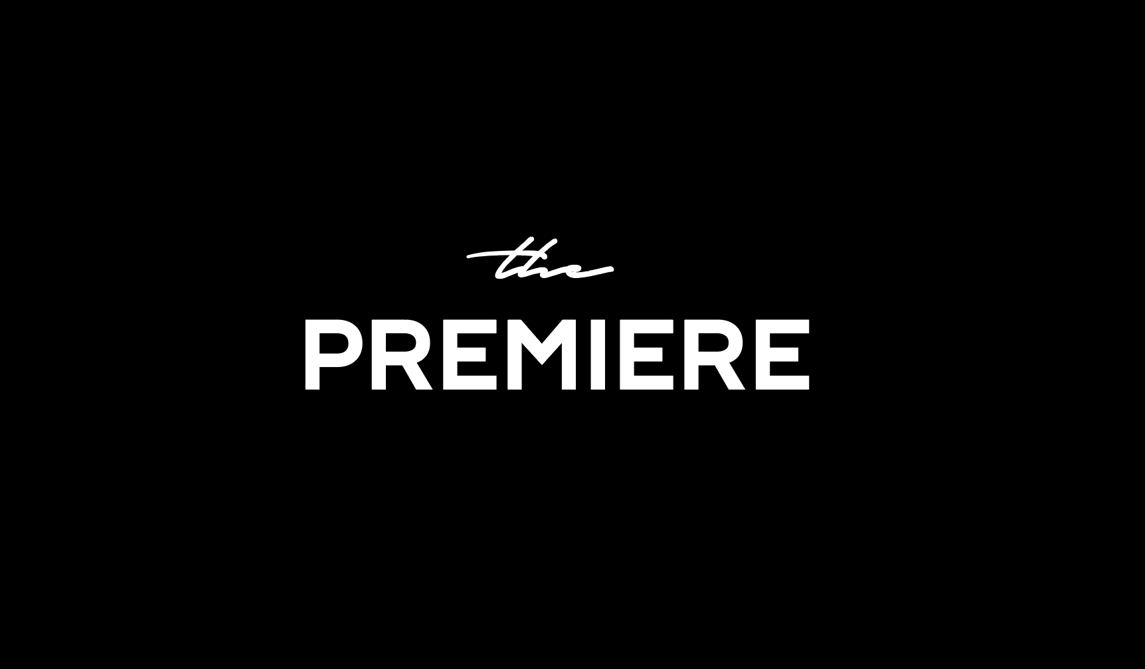

Slide 20
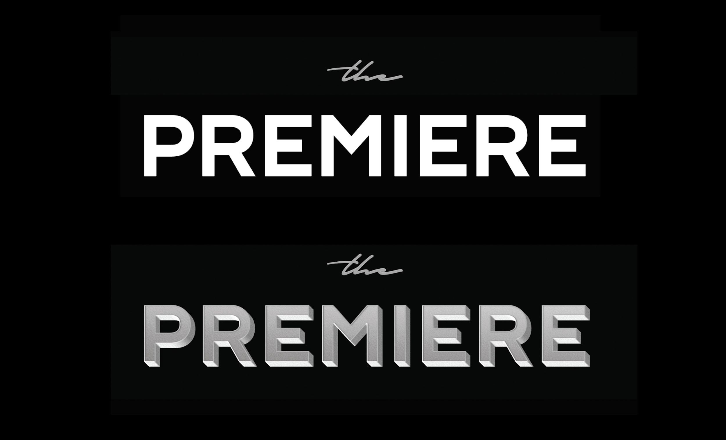
4
3

Slide 21
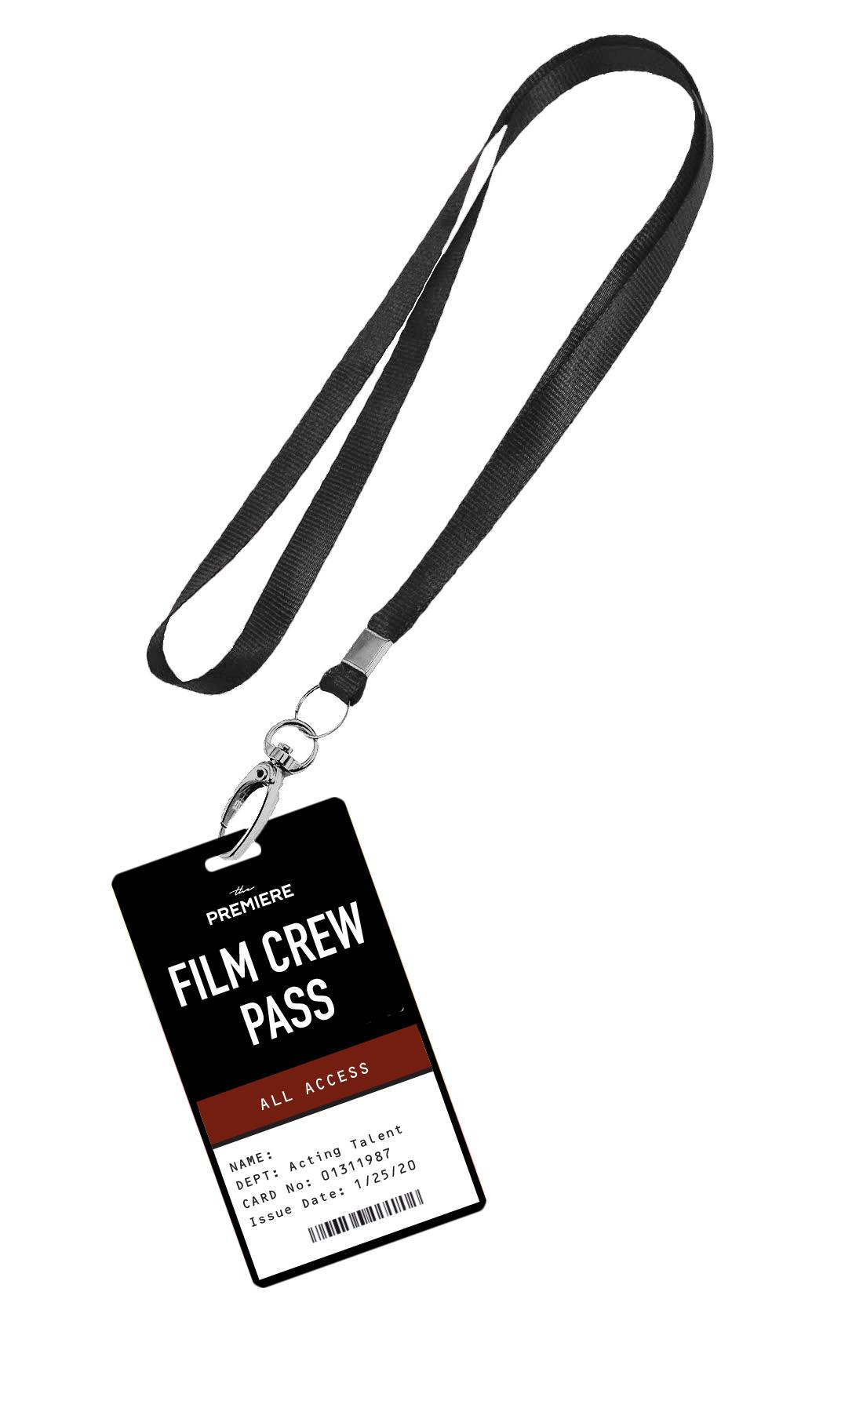
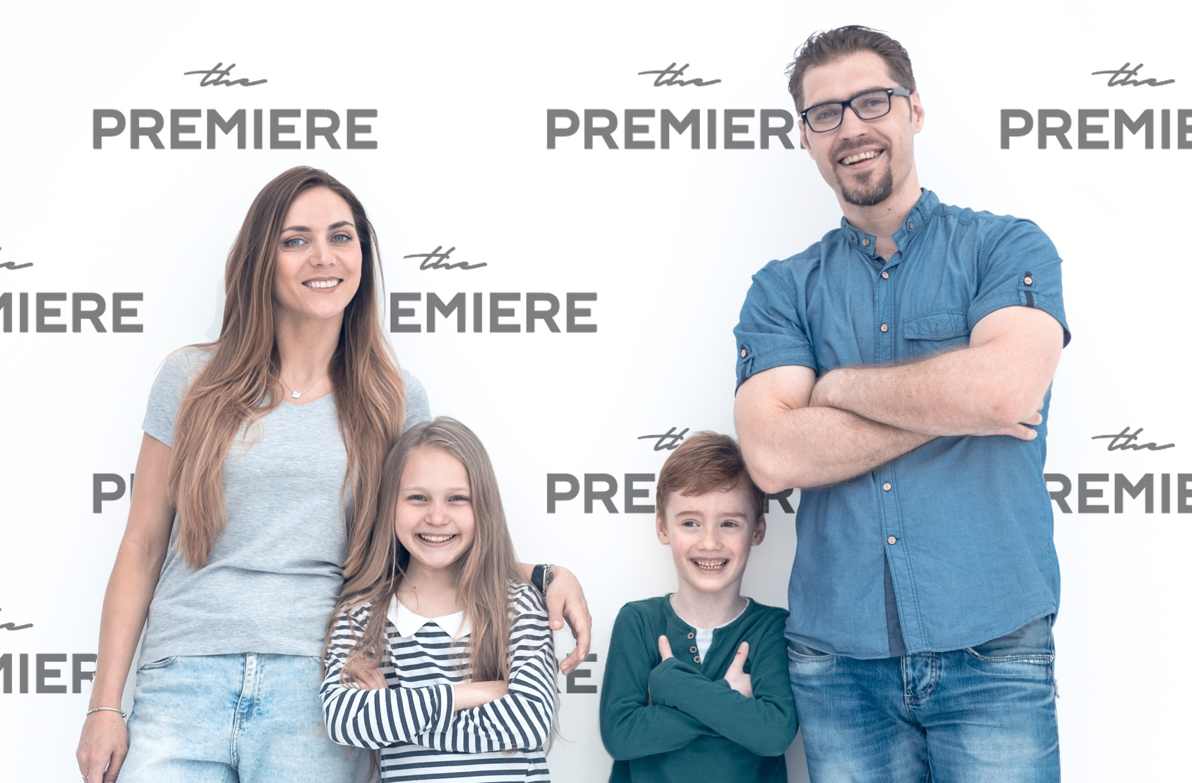
Logo Application | Merchandise
4

Slide 22


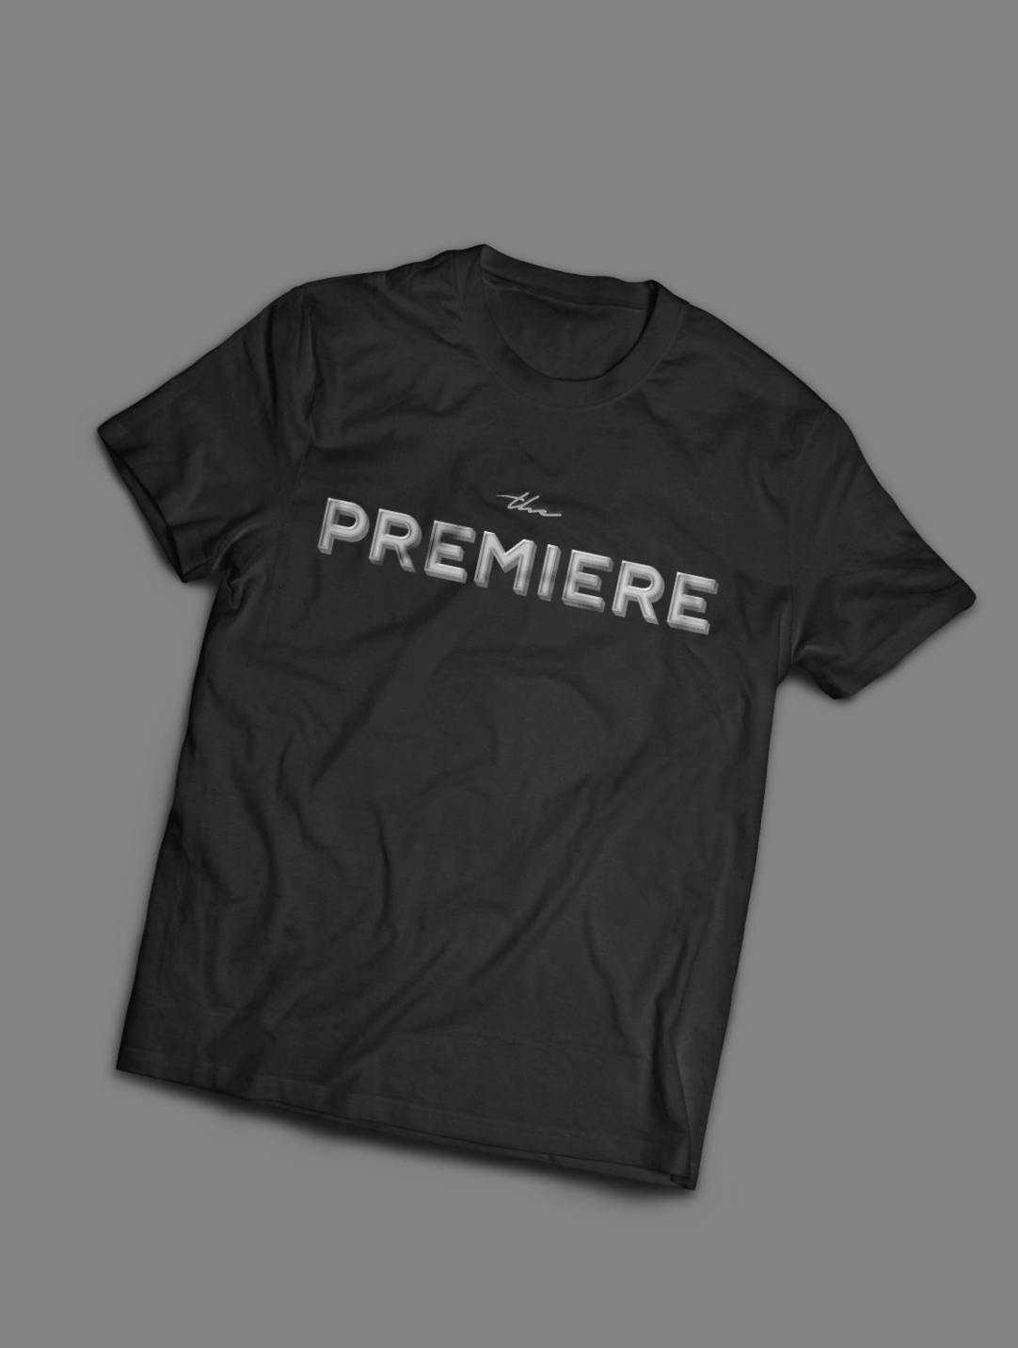
Logo Application | Merchandise
4

Slide 23
In Conclusion...
Overview of work. From-To highlights.
v
4

Slide 24
From:
Focus on private experiences for families, groups, and corporations at $5K+ per experience
3

Slide 25
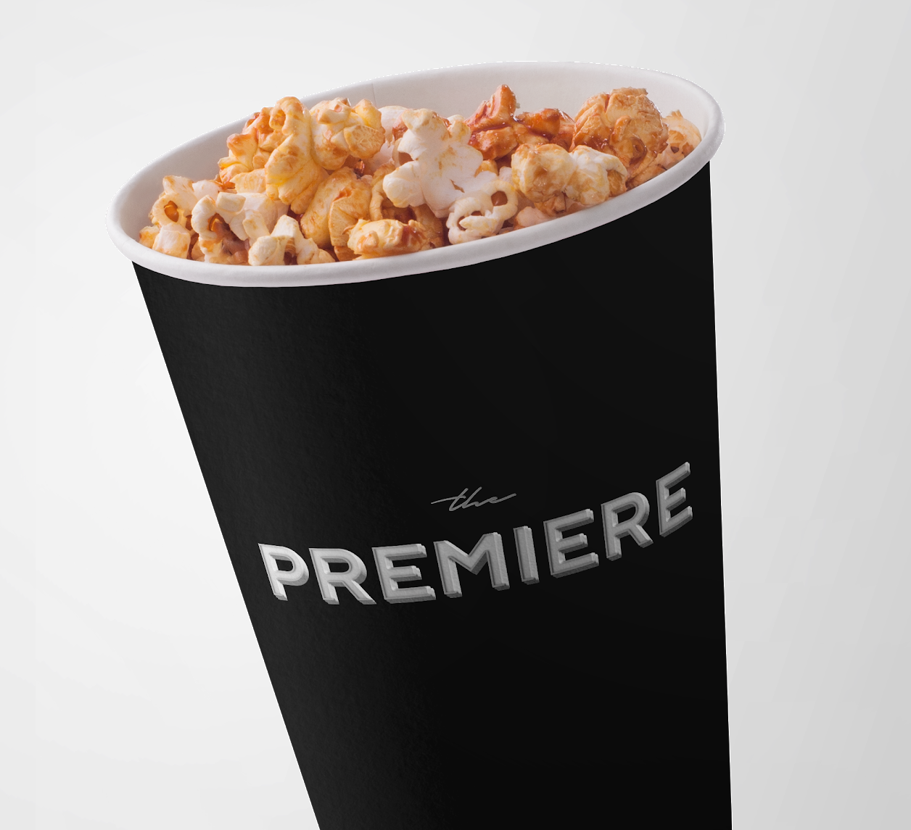
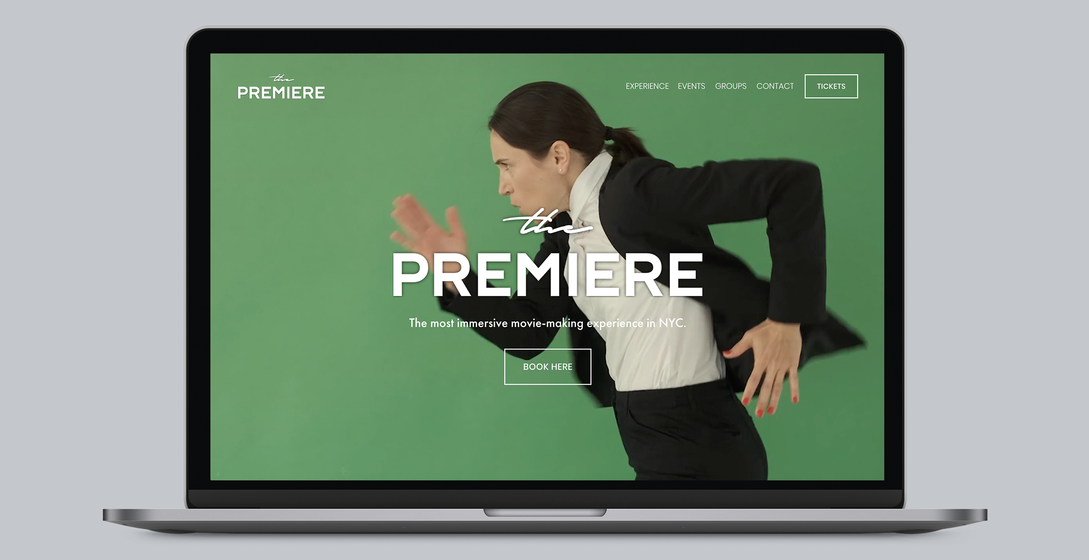
To:
Expanding to a ticketed event for everyone at $65+ per person
A modern, elevated experience with broader brand appeal.
3

Slide 26
Thats a wrap!
Thank you all.
v

Slide 27

Logo Application
Website
4
3

Slide 28
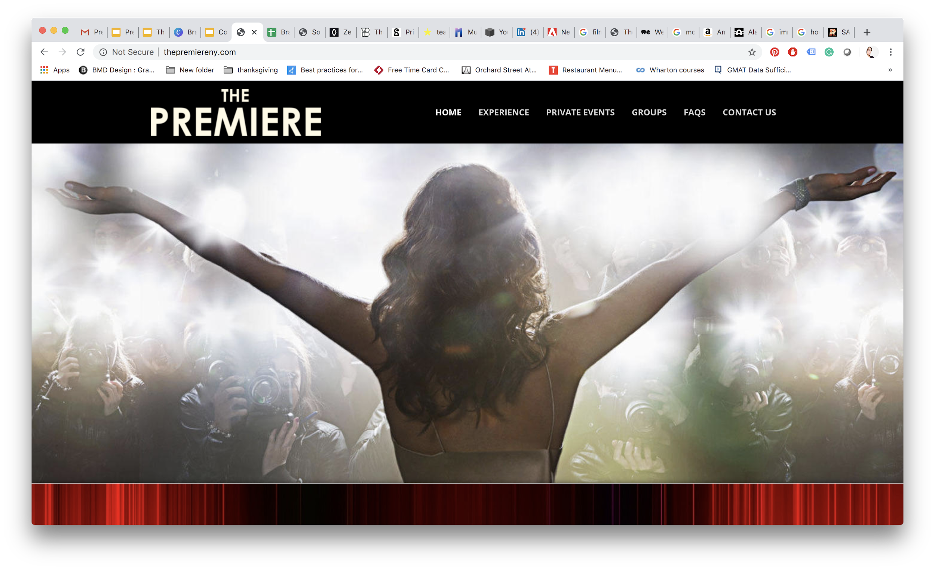
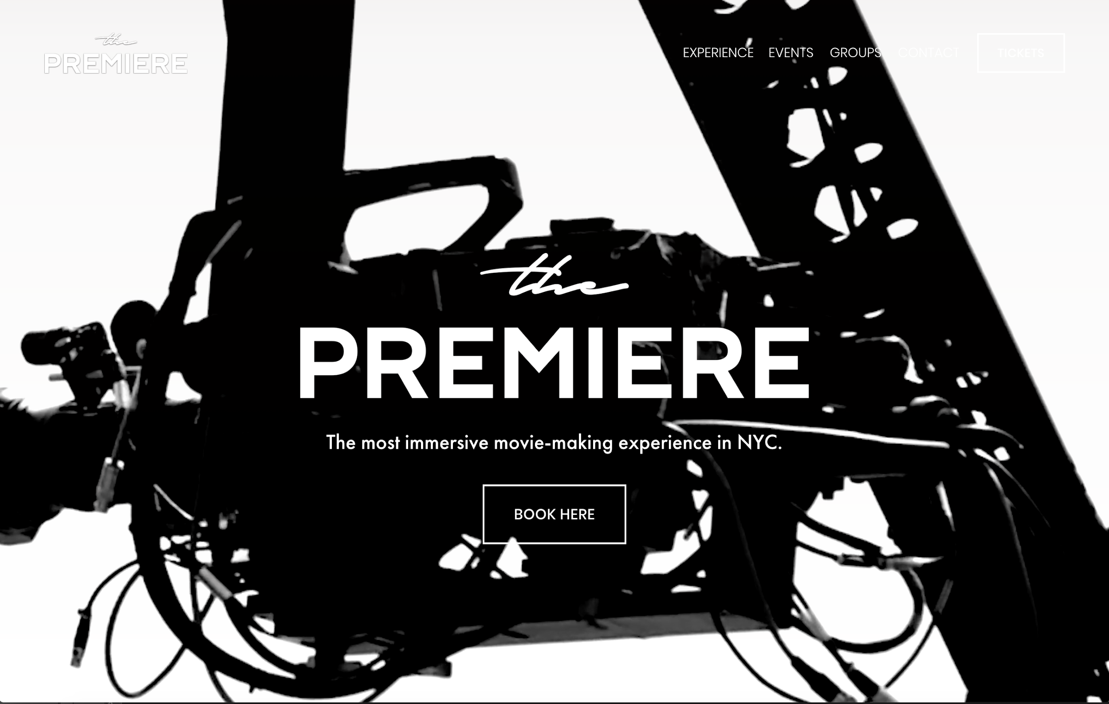
From
Validated business model via private experiences for families, groups, and corporations at $5K+ per experience
Expanding to a ticketed event for everyone at $65+ per person
$1.5M+ revenue and 200 experiences executed
4 cinematic concepts/genres
Seasoned 15+ person team
Floating location at Lincoln Center
Major marketing & sales channels in place (e.g. Expedia)
Configured technological specifications for roll-out
Individual, group, and event tickets
4,000+ shows & up to 125k guests per year per location
Content partnerships with movie franchises
Global locations with permanent flagship venue in NYC
Immersive capture green screen studios supported by automated video capture and editing platform

